Slide 1

LEVERAGING FREE TO-USE TECHNOLOGIES TO DEVELOP AN ADVANCED WEB-BASED IMAGE CLASSIFICATION MODEL

Slide 2
TABLE OF CONTENTS
Project Overview
Scope Of Project
Methodology
Results
Conclusion

Slide 3
PROJECT OVERVIEW
Objective
The main goal is to develop a web application that accurately classifies images using machine learning and free technologies.
Importance
Image classification has diverse applications, such as identifying diseases in healthcare, facial recognition in security, and automatic tagging in social media. An accessible tool can democratize these advancements.
Target Users
The application targets researchers, developers, small businesses, and educational institutions looking for affordable image classification solutions.

Slide 4
SCOPE OF PROJECT
Inclusions
Development of User-Friendly Interface: Ensures ease of access for users with varying levels of technical expertise.
Integration of a Machine Learning Model: Utilizing freely available libraries and frameworks for model development.
Support for Multiple Image Formats: Enabling diverse applications by supporting JPEG, PNG, and more.
Documentation and User Guides: Providing comprehensive resources to facilitate user onboarding and model utilization.

Slide 5
SCOPE OF PROJECT
EXCLUSIONS
Real-Time Video Processing: The focus remains solely on static images to maintain simplicity and efficiency.
Advanced Analytics: While basic metrics are included, more complex analytics will be considered for future versions.

Slide 6
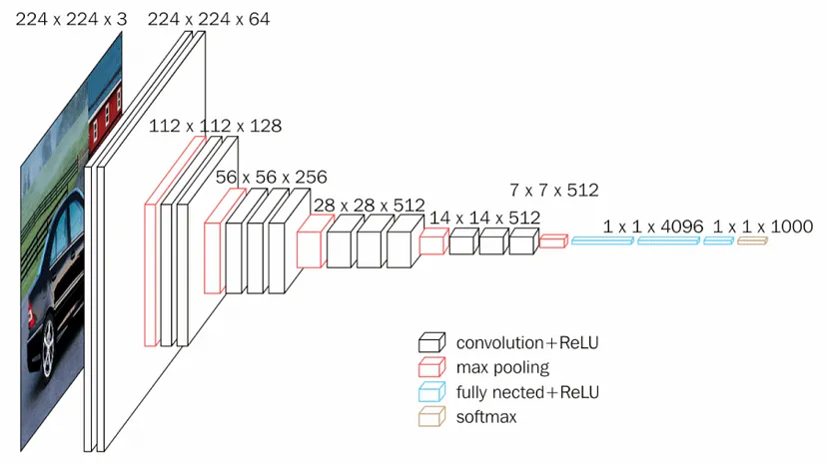
METHODOLOGY

Slide 7
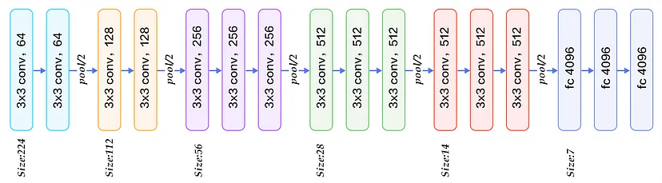
METHODOLOGY

Slide 8
METHODOLOGY
Data Collection & Pre-processing
Data Selection
Selected a well-known dataset (e.g., CIFAR-10, ImageNet) that contains a diverse range of images for robust model training and evaluation.
Data Augmentation
Rotation: Randomly rotating images to make the model invariant to orientation.
Zooming: Randomly zooming in/out to help the model learn to identify objects at different scales.
Flipping: Horizontal flips to increase dataset variability.
Normalization

Slide 9
METHODOLOGY
Model Architecture
VGG 19 Overview
Convolutional Layers: 16 convolutional layers with small 3x3 filters to capture spatial hierarchies in images.
Pooling Layers: 5 max pooling layers to reduce spatial dimensions and retain the most important features.
Fully Connected Layers: 3 fully connected layers at the end, where the final layer uses a softmax activation function for multi-class classification.
Transfer Learning
Utilized a pre-trained VGG19 model (trained on ImageNet) to leverage its learned features.

Slide 10
METHODOLOGY
Model Architecture
Transfer Learning
Utilized a pre-trained VGG19 model (trained on ImageNet) to leverage its learned features.
Removed the final classification layer and replaced it with a new fully connected layer tailored to the specific number of classes in the chosen dataset.

Slide 11
METHODOLOGY
Model Training
Training configuration
Compiled the model with an appropriate optimizer (e.g., Adam or SGD) and loss function (e.g., categorical cross-entropy for multi-class classification).
Set a learning rate schedule to adjust the learning rate during training, helping to optimize convergence.
Training Process
Trained the model on the training dataset while validating it on a separate validation dataset.
Employed callbacks like EarlyStopping to prevent overfitting and ModelCheckpoint to save the best model based on validation performance.

Slide 12
METHODOLOGY
Testing & Validation
Performance Matrix
Accuracy: Proportion of correctly classified images.
Precision and Recall: To evaluate the model's performance across different classes.
Confusion Matrix: To visually analyze classification performance across all classes.
Cross Validation
Implemented k-fold cross-validation to ensure that the model's performance is robust and not dependent on a specific train-test split.

Slide 13
METHODOLOGY
Deployment
Web App Framework
Integrated the trained VGG19 model into a web application using Flask or Django for the backend.
API Development
Developed RESTful APIs to handle image uploads and return classification results.
Frontend Interface
Designed a user-friendly interface using HTML/CSS and JavaScript, allowing users to upload images and receive real-time classification results.

Slide 14
RESULTS
Performance Matrix
Achieved an accuracy of approximately 90% on the test dataset, showcasing the model's effectiveness in classifying images.
Presented a confusion matrix to visualize classification results and identify areas for improvement.
Visualization
Included screenshots of the web application interface, illustrating ease of use.
Showcased examples of successful classifications, highlighting the model's capabilities.

Slide 15

RESULTS

Slide 16
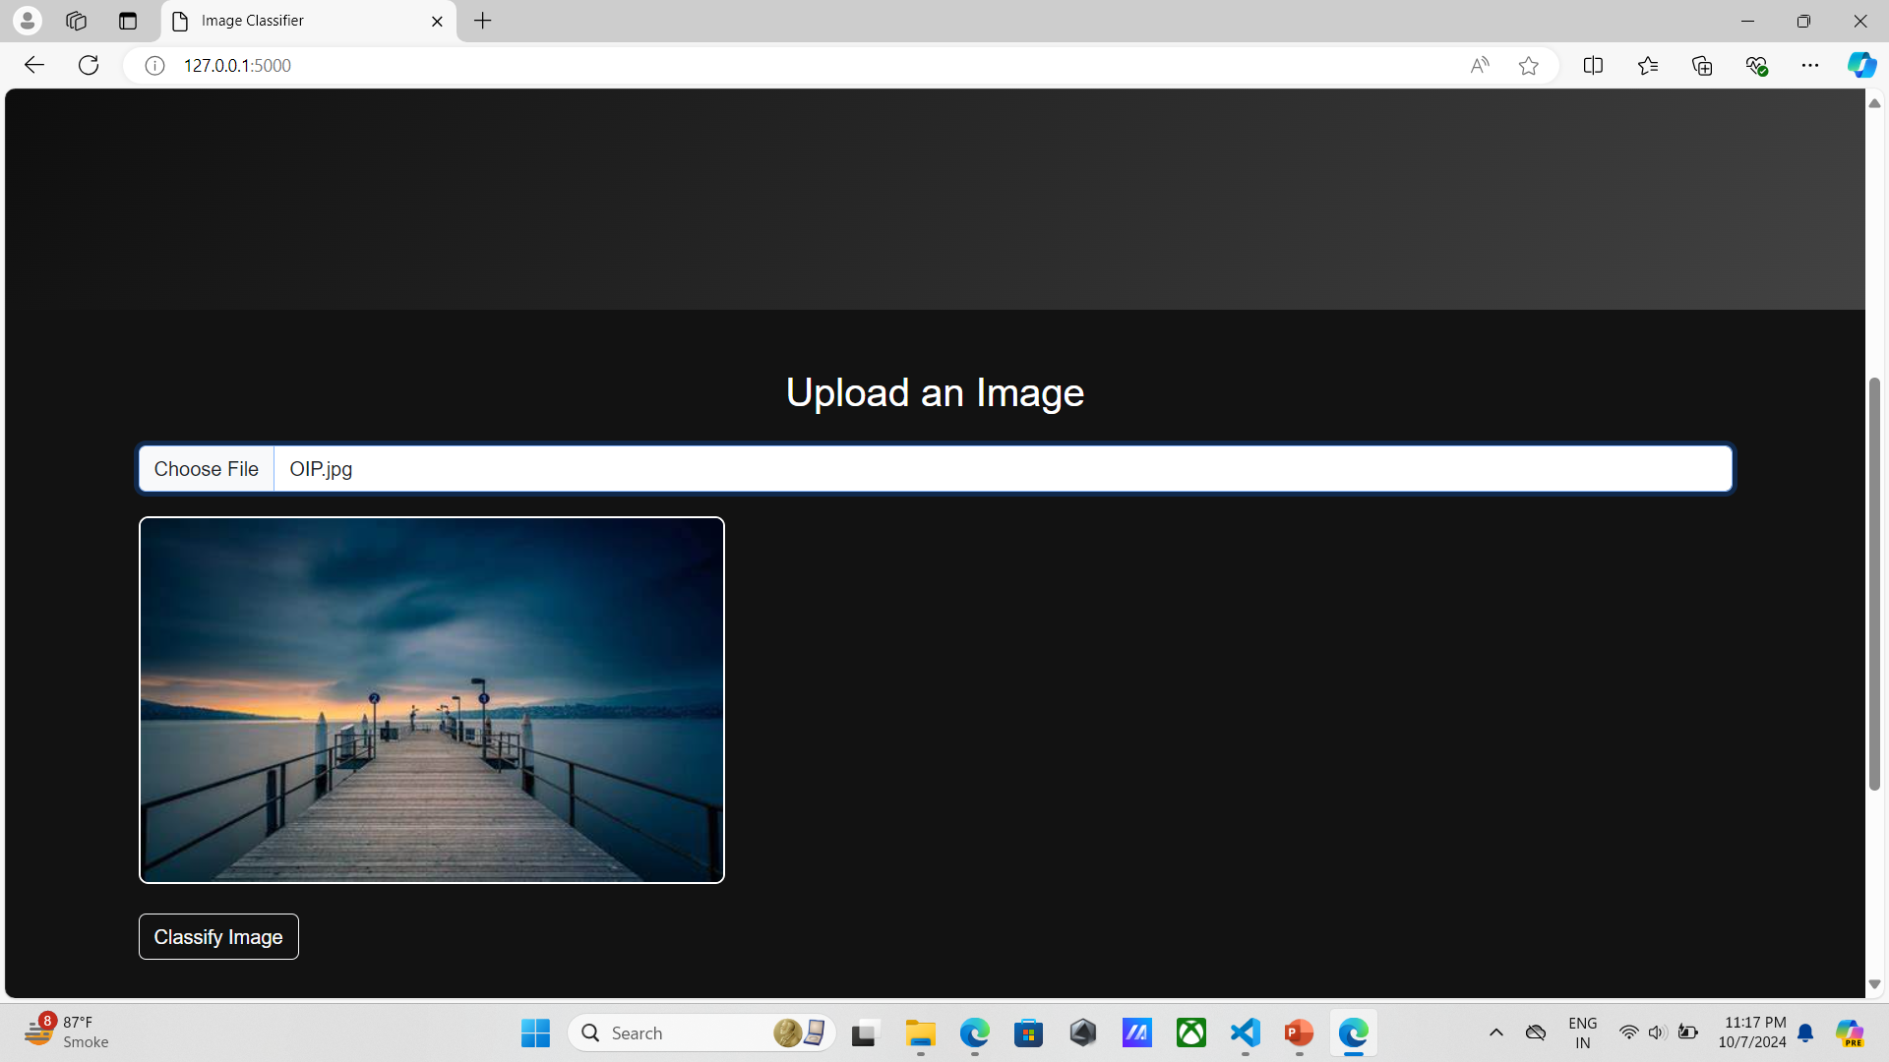
RESULTS

Slide 17
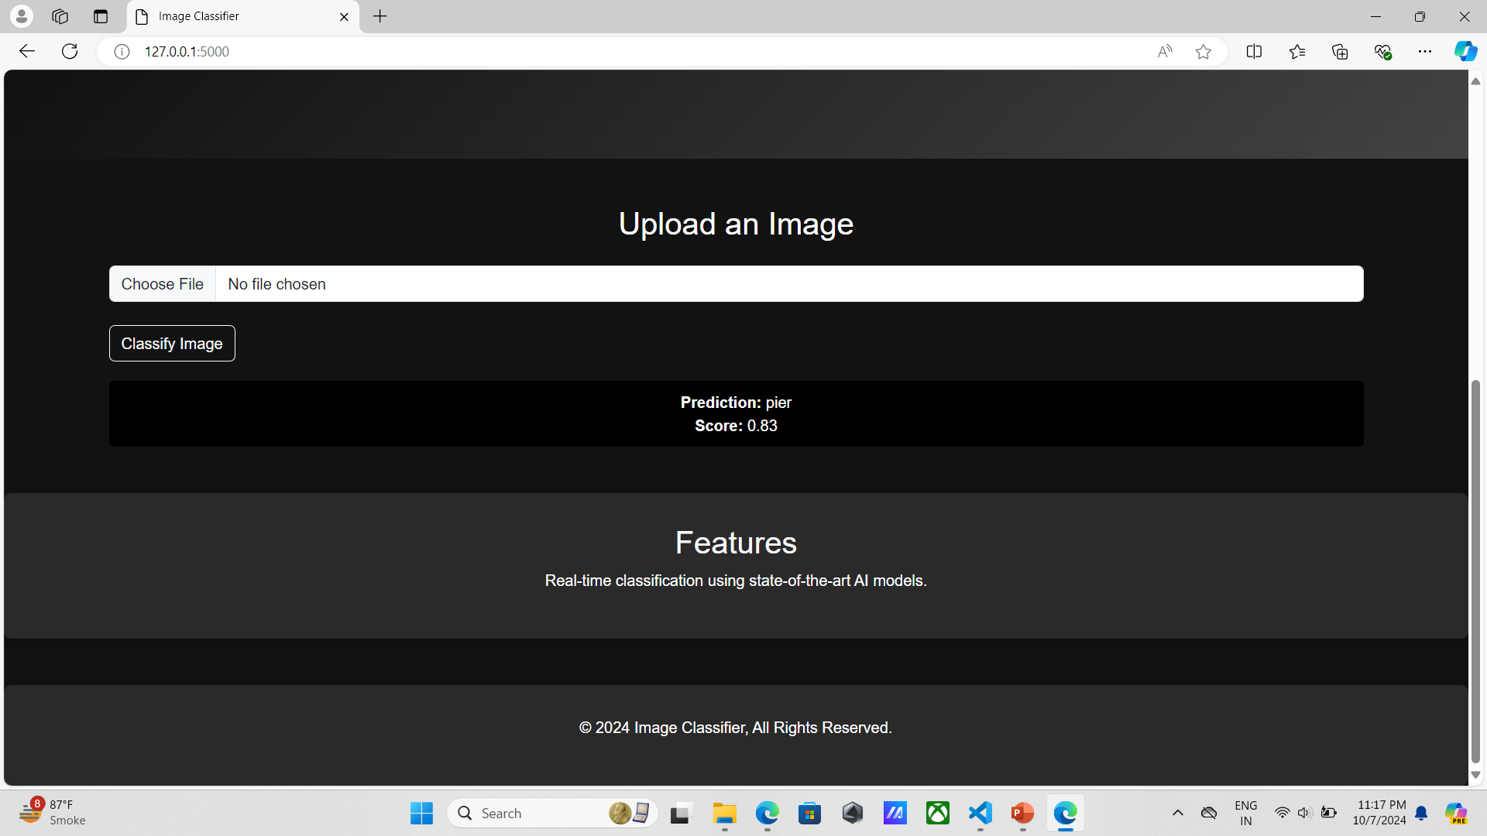
RESULTS

Slide 18
REFERENCES
Simonyan, K., & Zisserman, A. (2014). Very Deep Convolutional Networks for Large-Scale Image Recognition. arXiv preprint arXiv:1409.155
Chollet, F. (2018). Deep Learning with Python. Manning Publications.
TensorFlow. (2023). TensorFlow Documentation. Retrieved from https://www.tensorflow.org/
Keras. (2023). Keras Documentation. Retrieved from https://keras.io/
Flask. (2023). Flask Documentation. Retrieved from https://flask.palletsprojects.com/
PyImageSearch. (2021). Understanding VGG16 and VGG19 Convolutional Neural Networks. Retrieved from https://www.pyimagesearch.com/2021/02/01/understanding-vgg16-and-vgg19-convolutional-neural-networks/

Slide 19
THANK YOU!

